Slide 1

Progress on the 2016 Summit Resolutions

Slide 2


Background
EPWP Summit has become a strategic platform, where public bodies from all spheres of Government meet to discuss the implementation of the Expanded Public Works Programme (EPWP), share ideas and engage on best practices.
On the 15-17 November 2016, the National Department of Public Works hosted the 5th EPWP Summit in St. George Hotel and Convention Centre, in Gauteng.
The 2016 EPWP Summit took place shortly after the local government elections (i.e. 3rd August 2016).
The Summit was hosted under the Theme: “See, feel and experience the EPWP”.

Slide 3
Background continued ...(2)
The Summit aimed to achieve the following objectives:
  Review and report progress since the launch of EPWP phase 3 in 2014.
  Orientate the newly elected local government leadership on broad EPWP principles and responsibilities of local government to achieve the EPWP targets.
  Agree on mechanisms to resolve implementation and reporting challenges and non-adherence to the EPWP Ministerial Determination.
  Share good practices on the coordination, implementation and reporting on the programme.
  Outline key elements of achieving sustainable livelihood through EPWP.
  Highlight the contributions of Public Employment Programmes (PEPs) to the country and beyond the creation of work opportunities.

Slide 4
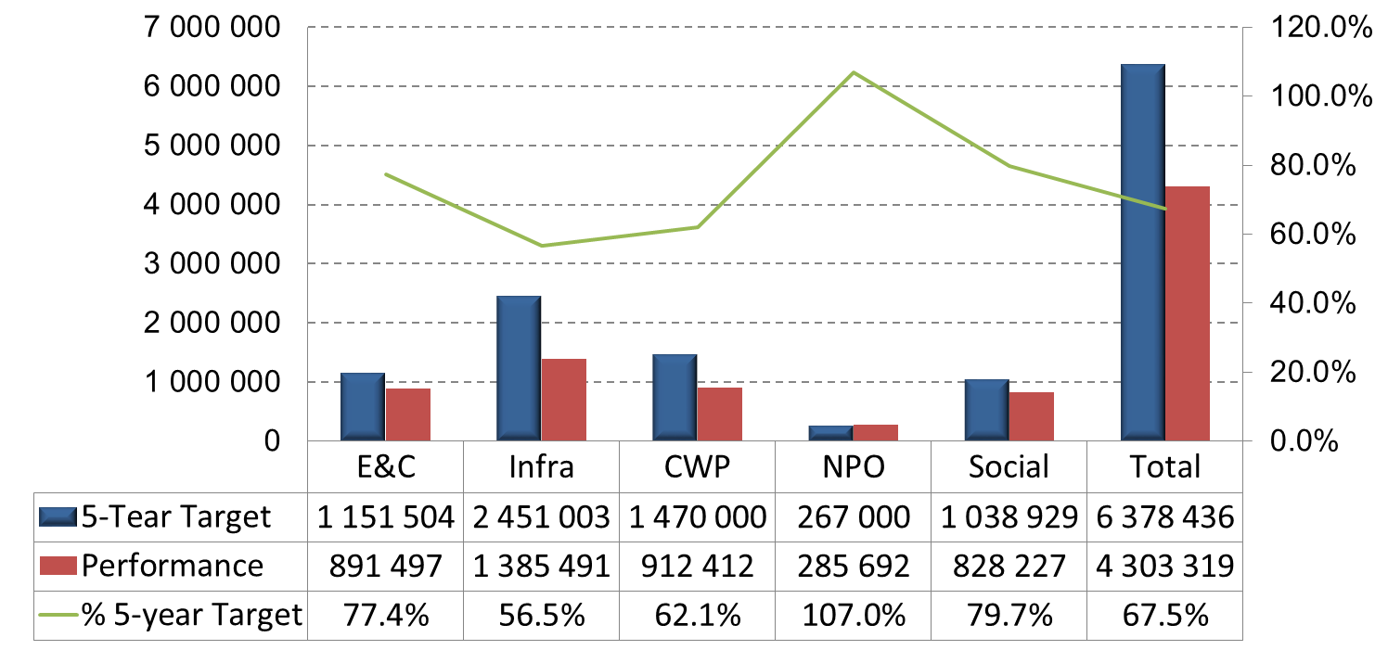
Progress on the Implementation of the 2016 Resolutions
RESOLUTION 1: Noting, the under-reporting in 15/16 financial year, the Summit resolves that all public bodies will intensity their efforts to report on work opportunities so as to enable the attainment of the 6 million work opportunity target. The EPWP Reporting System will be used as the authentic source of reporting on the programme. Technical support will be provided in this regard.
All EPWP public bodies are reporting EPWP work opportunities through the EPWPRS. Efforts have been intensified, especially in the 2018/19 financial year. However, a shortfall against the work opportunity target still remains.

Slide 5
Progress on the Implementation of the 2016 Resolutions
RESOLUTION 2: The Summit notes progress made in the signing of protocols for EPWP phase 3 and resolved that targets in the protocol agreements should be monitored.
The progress is being monitored and total compliance is 53% overall. Varying performance is noted across provinces.

Slide 6
Progress on the Implementation of the 2016 Resolutions
RESOLUTION 3: The Summit notes progress made in the alignment of EPWP municipal policies to EPWP phase 3 requirements. Municipalities should ensure that this process of aligning EPWP policies should continue and be completed by 30th June 2017. The national DPW and Provincial Department of Public Works will continue to provide technical support to Municipalities in this regard.
Overall performance is at 57%, with only GP reaching 100%. Further efforts are required for the resolution has not been achieved. Implementation of Policies also need to be monitored.

Slide 7
Progress on the Implementation of the 2016 Resolutions
RESOLUTION 4: The Summit notes the progress made in appointing dedicated officials by public bodies at appropriate level of seniority for EPWP and resolved that all spheres of government should ensure that there is dedicated capacity to coordinate and implement EPWP. Public bodies should ensure that EPWP targets are incorporated in the performance agreements of senior managers.
In some public bodies, progress has been made such as in the case of City of Johannesburg. However, capacity at a municipal sphere level remains a challenge.
Department of Environmental Affairs has fully institutionalised the co-ordination function for PEPs in the sector.
Research undertaken by DPME has recommended that more capacity be availed for coordination in the Social Sector.
Provincial Coordinating Departments have largely institutionalised the Programme. There are provinces were co-ordination has weakened.
Improvements are underway in the NSS to address institutional and capacity challenges.
On average, EPWP targets have not been incorporated in the performance agreements of senior managers.

Slide 8
Progress on the Implementation of the 2016 Resolutions
Resolution 5: The Summit acknowledges progress made in the establishment of EPWP Governance Structures. The national DPW, Provincial Departments and lead sector departments will ensure that EPWP governance structures meet on a regular basis, at least quarterly to address key challenges with regard to programme implementation.
National Sector Committees
NCC | Has been resuscitated and meets on a frequent basis.
E&C (Quarterly) | Functional and convenes on a quarterly basis.
Infrastructure (Quarterly) | Functional and convenes on a quarterly basis. EPWP Provincial Roads Coordinating Committee and National Youth Service Committees meet regularly on quarterly basis. EPWP Cities Network Reference group meets quarterly.
Non-State Sector (Quarterly) | Functional and convenes on a quarterly basis.
Social Sector (Quarterly) | Functional and convenes on a quarterly basis.
Provincial Steering Committees: Provincial Steering Committees are functional and sit on a quarterly basis.
District Steering Committees: Most provinces have functional DSCs. However, there are some provinces that do not have regular DSC forum sittings on a regular basis.

Slide 9
Progress on the Implementation of the 2016 Resolutions
RESOLUTION 6: The Summit notes the lack of full compliance by public bodies to the Ministerial Determination on their EPWP projects and resolves to ensure compliance. NDPW undertakes to develop a Standard Operating Procedure that will spell out the roles and responsibilities of different stakeholders with regard to audit requirements
Audit Standard Operating Procedure developed, consulted and approved by the Director General: Department of Public Works on the 13 June 2018.
Recruitment Guidelines developed, consulted and approved by the Minister of Labour (December 2017).
There is lack of full compliance to the Ministerial Determination: EPWP. The EPWP has been receiving negative audit findings due to lack of records kept by public bodies in terms of Section 12 of the Ministerial Determination.

Slide 10
Progress on the Implementation of the 2016 Resolutions
RESOLUTION 7: The Summit resolves that municipalities should continue to prioritise EPWP in their Integrated Development Plans (IDPs). Public bodies need to ensure that they compile to the requirements of the different grants to optimise the creation of work opportunities that contribute towards the EPWP. Public bodies should also optimise their non-grant funding towards EPWP.
The Auditor General reports on the EPWP states that not all public bodies report EPWP projects implemented.
There has been poor progress on utilising own funds for EPWP. Provincial departments and municipalities continue to rely on the EPWP Grants.

Slide 11
Progress on the Implementation of the 2016 Resolutions
RESOLUTION 8: The Summit resolves that a national EPWP policy will be developed by 30 June 2018.
The process of developing an EPWP policy has been delayed. A two phased approach to developing the policy is being undertaken:
  Phase 1: Desktop method - collate the existing documentation on EPWP and body of knowledge from phase 1 to phase 3 to develop a policy of EPWP in its current form. Phase 1: Completed in September 2018.
  Phase 2: Review the policy developed in phase 1 above and widely consult key stakeholders on the futuristic EPWP Policy. Phase 2 process started end of October 2018 and will be completed by October 2019 (estimated date).

Slide 12
Progress on the Implementation of the 2016 Resolutions
RESOLUTION 9 The Summit resolves that public bodies should set aside part of their budgets to fund the training of participants on their projects. NDPW and all lead sector departments will continue to liaise with relevant stakeholders to source additional funding for training and ensure that quality training is provided to EPWP participants, in-line with EPWP sector training strategies.
Source: EPWPRS: Table 8 (Data Capture reports: 2016-2018). Public bodies are generally not using much of their own funding for training, with the exception of the Department of Environment Affairs and Department of Tourism.

Slide 13
Progress on the Implementation of the 2016 Resolutions
RESOLUTION 9 (continued): The Summit resolves that public bodies should set aside part of their budgets to fund the training of participants on their projects. NDPW and all lead sector departments will continue to liaise with relevant stakeholders to source additional funding for training and ensure that quality training is provided to EPWP participants, in-line with EPWP sector training strategies.
In EPWP Phase 3, DPW liaised with stakeholders to secure training funds.
Department of Higher Education and Training has funded the training of:
172 artisans
250 learnerships
15210 skills programmes
Local Government SETA has funded:
795 skills programmes
Financial Sector Conduct Authority and DPW has funded:
15 210 EPWP participants capacitated on financial literacy

Slide 14
Progress on the Implementation of the 2016 Resolutions
RESOLUTION 10: The Summit resolves that the national DPW and all lead sector departments will continue to provide technical support to all spheres of government to promote the implementation of the EPWP in the use of labour-intensive methods, promotion of community involvement, sustainable livelihoods, and convergence.
Technical Support provided to the following:
National Departments of Public Works (Projects branch);
Transport, Water and Sanitation, and Energy;
State Owned Entities (SOEs), including Eskom and Umgeni Water;
Provincial Departments of Transport, Public Works and Human Settlements.
45 Provincial Department of the Social Sector (Departments of Health, Education, Social Development, Community Safety and Sports Recreation of South Africa);
National and Provincial Departments of the Environment Sector (Departments of: Environmental Affairs; Tourism; Energy; Arts and Culture, Agriculture, etc.);
Technical Support provided to 257 municipalities;
350 NPOs that are participating in the Non-State Sector.

Slide 15
Progress on the Implementation of the 2016 Resolutions
RESOLUTION 11: The Summit resolves that in the pursuance of EPWP objectives, coordinating departments and public bodies shall establish partnerships with state and non-state actors.
The following partnerships have been established with:
Council for Scientific and Industrial Research (CSIR) on total quality management of the Vuk’uphile Learnership Programme.
MoA with the Council for the Built Environment – to ensure mainstreaming of labour-intensive methods within the Built Environment Councils and the Review of the Civil Engineering Curriculum to include labour – intensive methods.
MoA with the International Labour Organisation to provide technical support on EPWP.
Department of Home Affairs on the verification of EPWP participants against the National Population Register.
Nedbank on the provision of bridging finance for contractor on the Vuk’uphile Learnership Programme

Slide 16
Progress on the Implementation of the 2016 Resolutions
RESOLUTION 11: The Summit resolves that in the pursuance of EPWP objectives, coordinating departments and public bodies shall establish partnerships with state and non-state actors.
The following partnerships have been established with:
MoA with Department of Communications on the Digital Migration Programme. The partnership was to train set-top box installers.
MOA with the Department of Small Business Development to support SMMEs within EPWP.
DHET/NSF partnership to train EPWP participants through skills programmes, learnerships and artisan development.
MoA with the Independent Development Trust on the implementation of the EPWP Non-Profit Programme.
GIZ partnership study on the implementation of he Violence and Crime prevention programme at local level.

Slide 17
THANK YOU!
Expanded Public Works Programme
17
Notes:
17

